Slide 1
A statistical study on the role of artificial intelligence in developing education from the point of view of higher education students at the College of Administration and Economics Supervised by Lec:Esraa A. Haydier Prepared by students Abdullsamad mohammed Ahmad Pola Sardar Hussein Ibrahim Abdullah Ahmad

Slide 2
Research objective
The research aimes to
1- Identify the importance of artificial intelligence in the educational process.
2- The use of artificial intelligence in education allows improving the level of students and enhancing the effectiveness of the learning process through advanced technology and innovative solutions​.

Slide 3
The Importance of Research for the University
The university is considered one of the most important social institutions that works to prepare qualified and trained individuals in various fields, professions and specializations. Improving the quality of higher education means achieving development and improvement in the university education system. This includes raising the level of academic programs, modernizing curricula, developing teaching and evaluation methods, improving the scientific research environment, encouraging innovation, increasing business, and enhancing communication and cooperation with universities, as artificial intelligence is considered one of the modern sciences and computer science.​He believes that “AI may replace the human factor in all fields in the long term

Slide 4
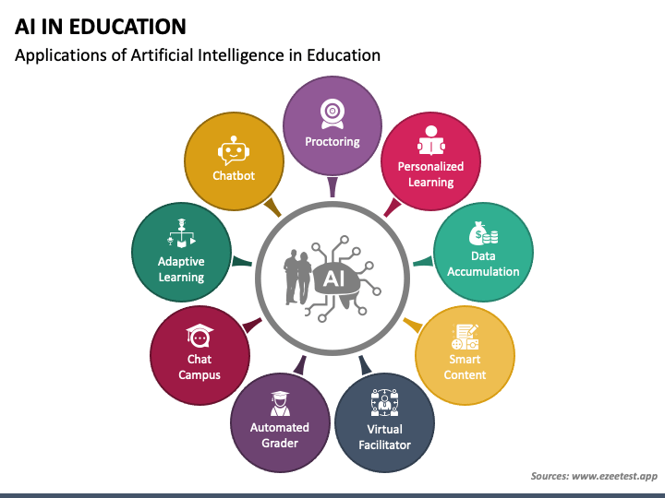

Slide 5
Thank you for listening

